Slide 1
South Korea Lookin’ Fine

Slide 2
fashion

Slide 3
Seoul Fashion Week
Bi-annual
Expected visitors: 20,000 - 50,000
Approximate exhibitors: 500+
Early bird ticket: 66,000 won
About $59 USD

Slide 4
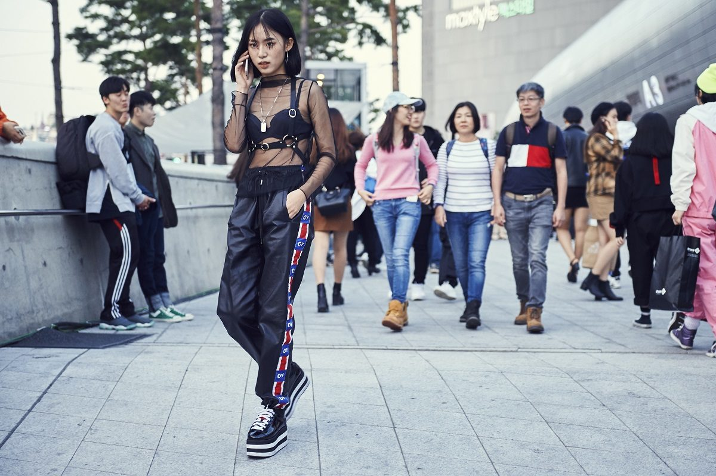
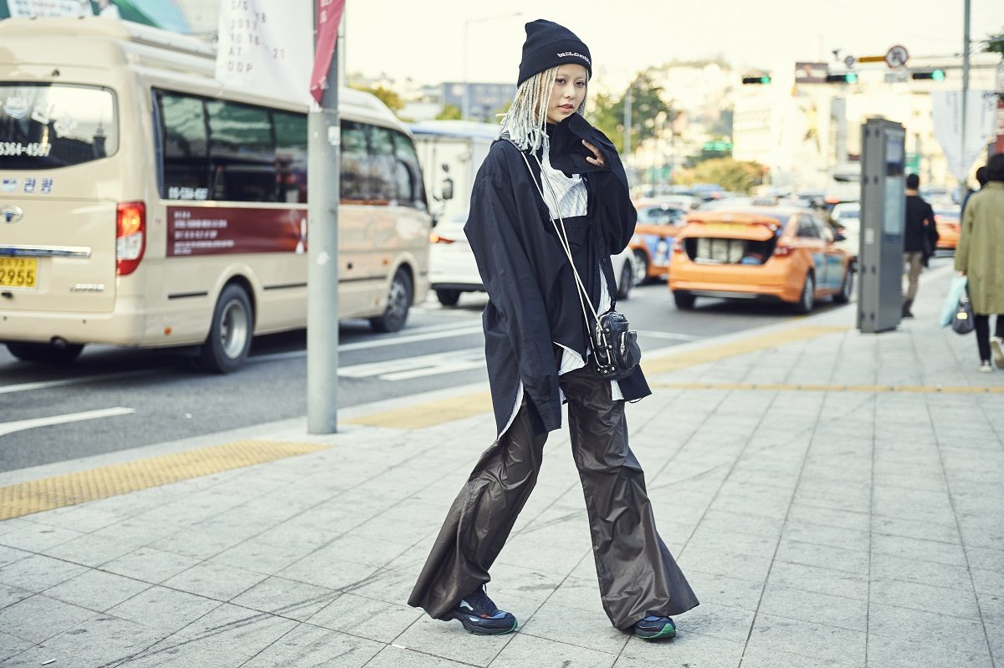
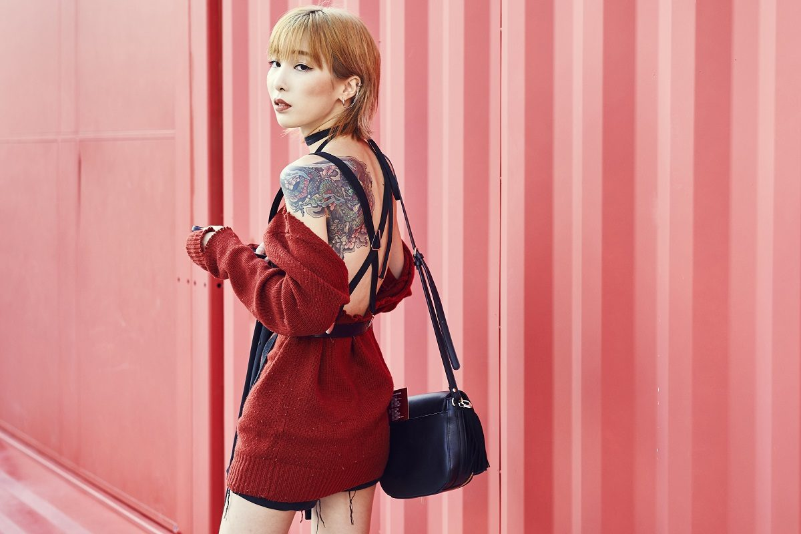

Slide 5
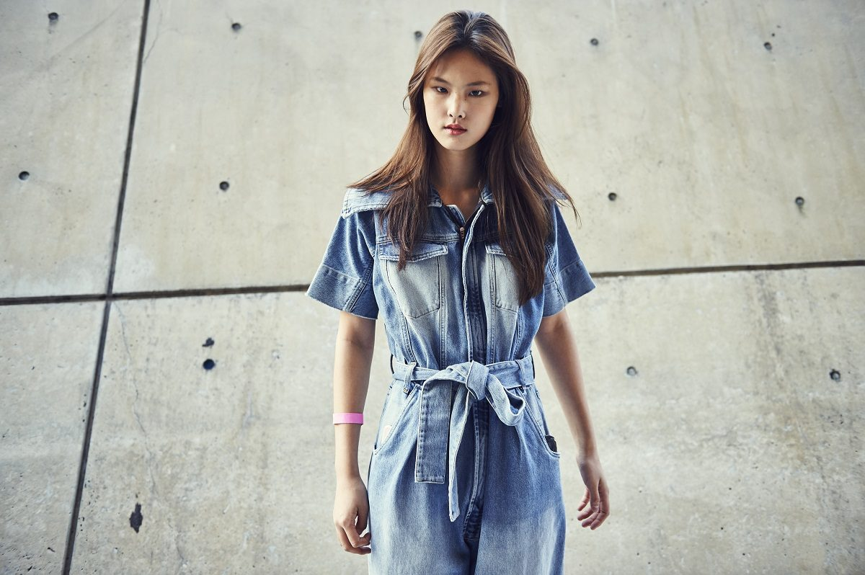
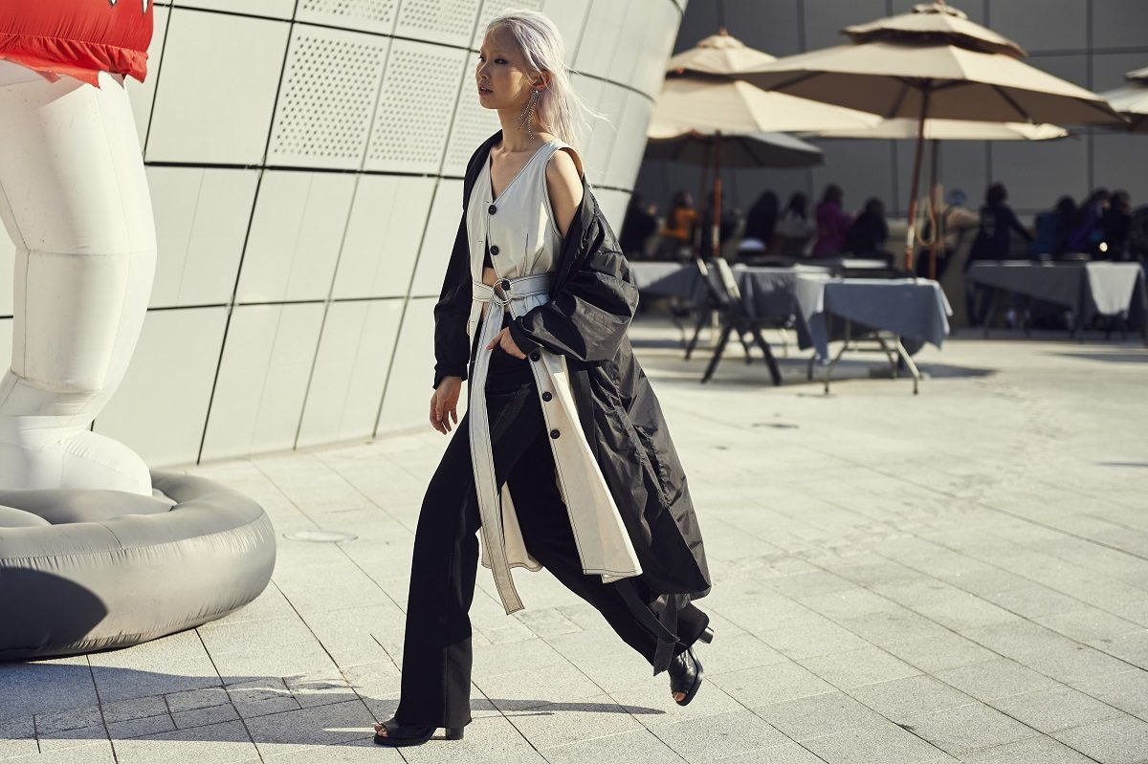
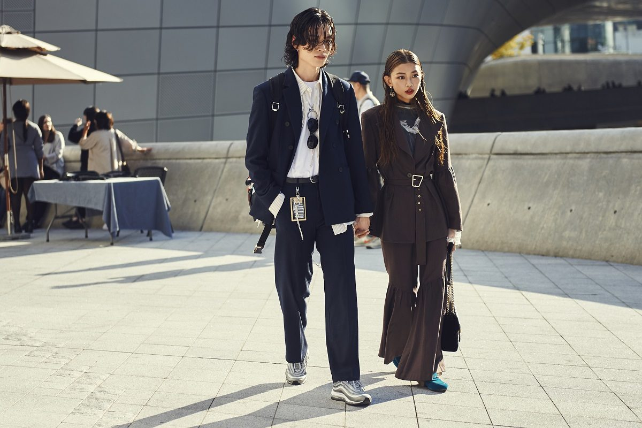

Slide 6
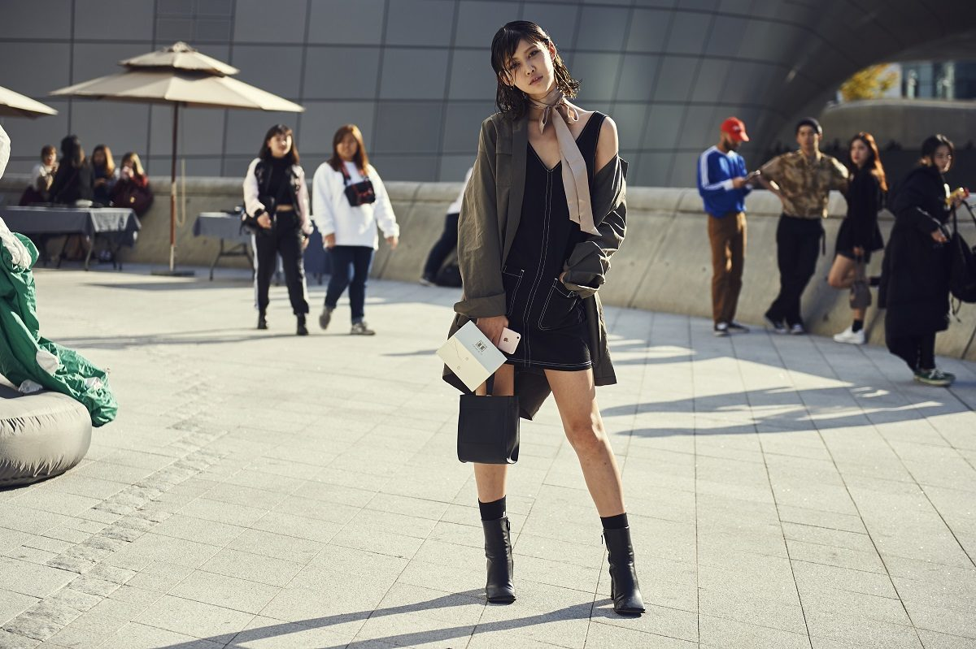
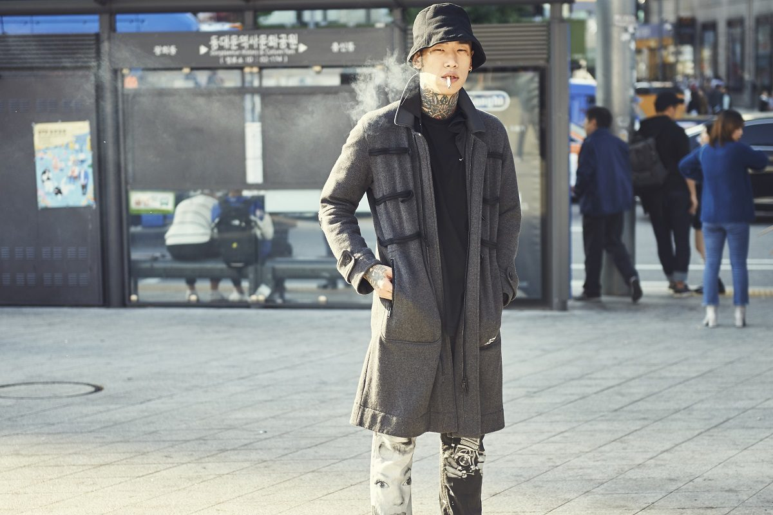
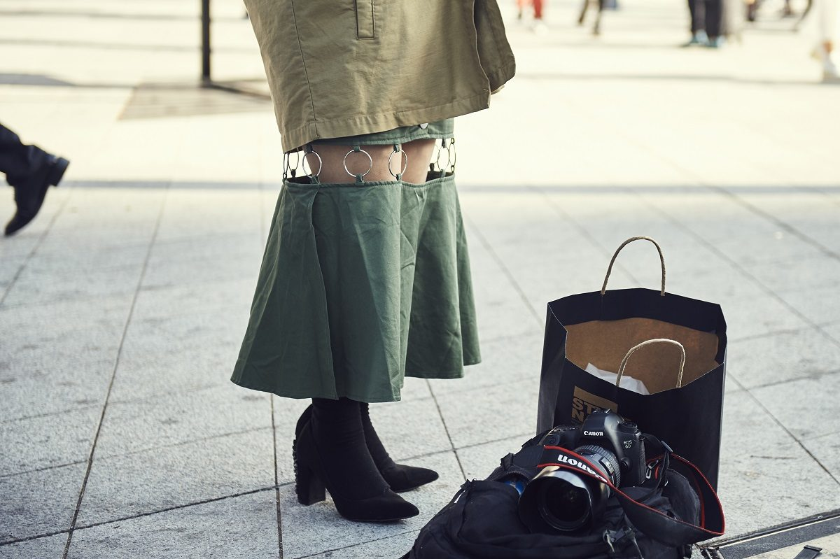

Slide 7
Fashion styles

Slide 8
ulzzang
fashion
Online popularity due to looks
Tips:
Matching outfits (couples)
Loose & tight combo
Bright colors
Bold prints

Slide 9
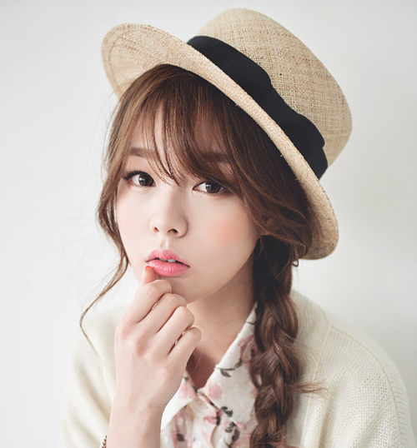
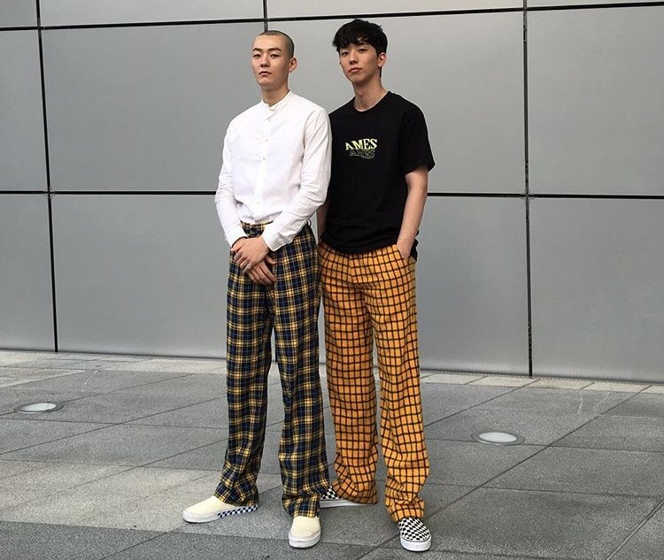
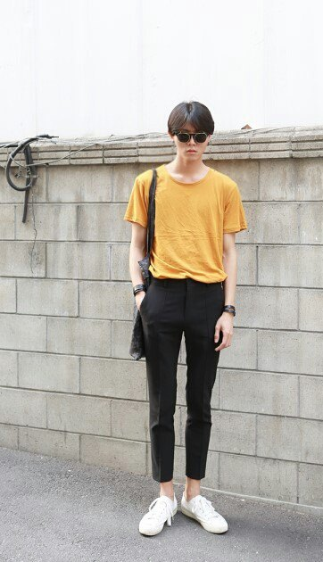
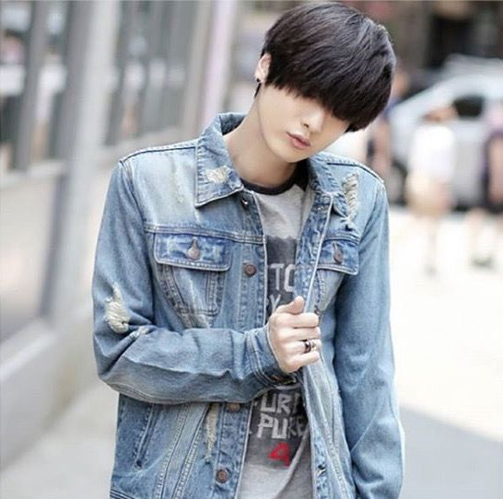
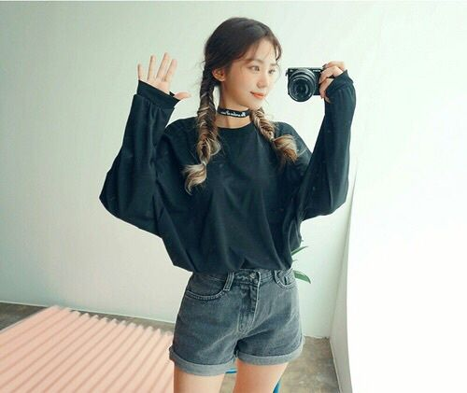

Slide 10
Hip-Hop Fashion
Roots: 1980’s America
Tips:
Harem pants
Baggy shirts
Glitter/gold
Snapback caps
Tattoos
Hip-hop sneakers
Masculine/tomboyish

Slide 11
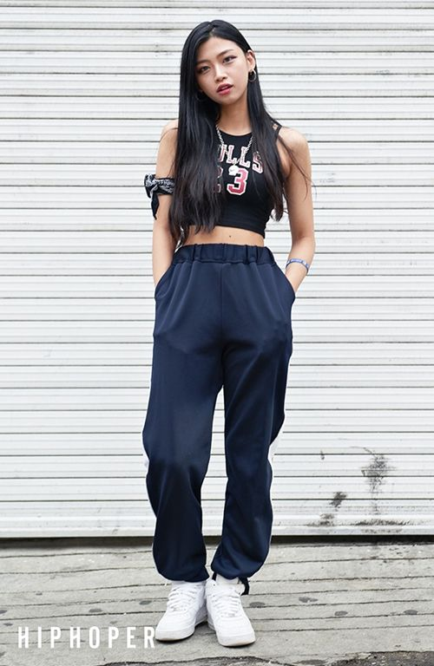
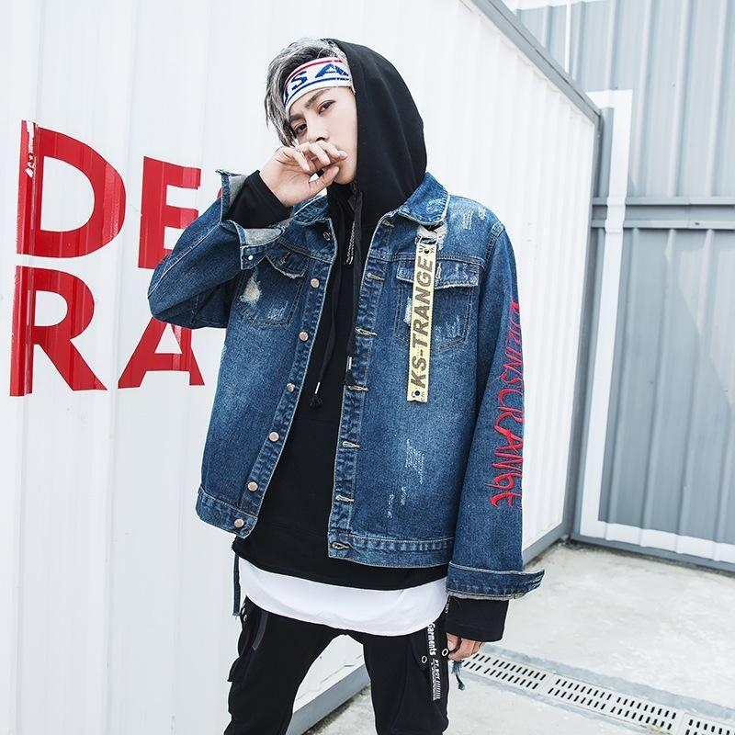
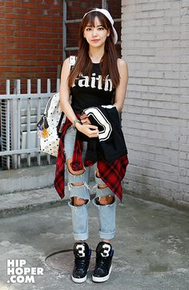

Slide 12
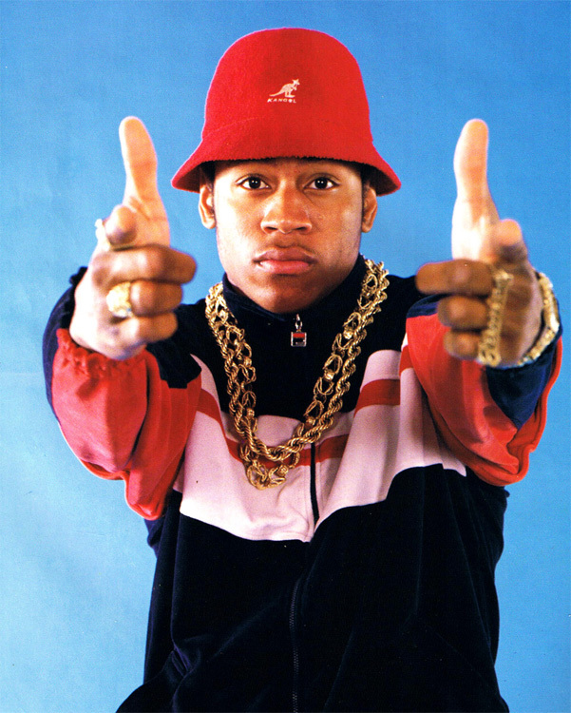
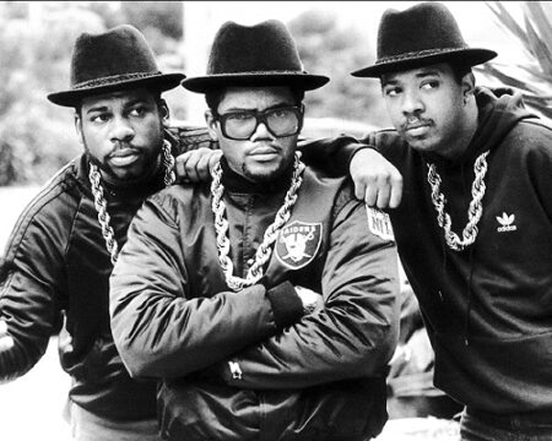
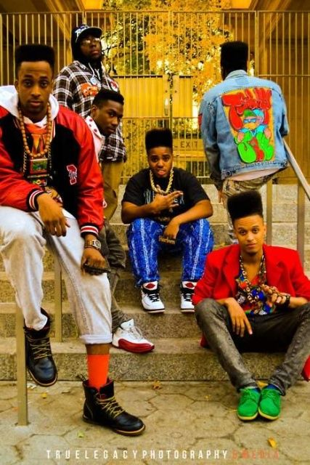

Slide 13
Joseon Punk
Fashion
Outcast/young adult subculture
Roots: 1990’s American punk-pop
Nirvana
Greenday
Not very inclusive of women
Tips:
Oversized shirts
Baggy pants
Self-expression - switch it up!

Slide 14
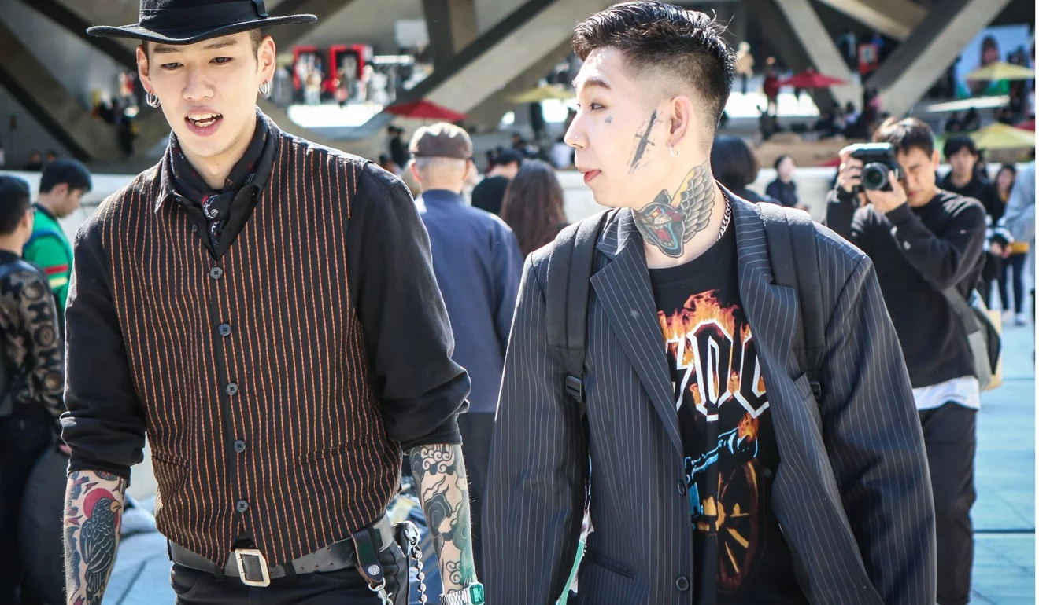
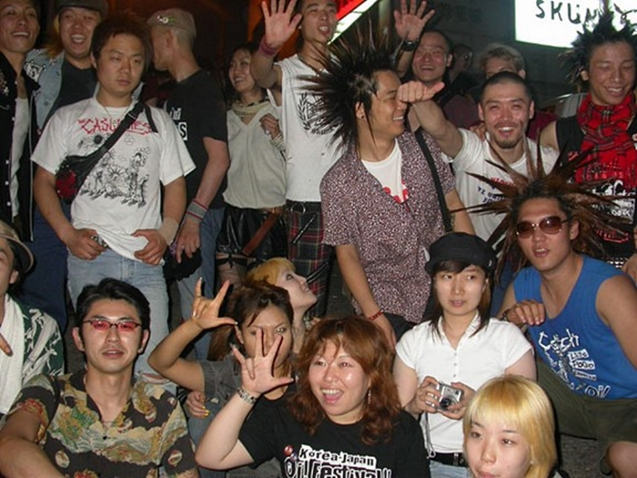
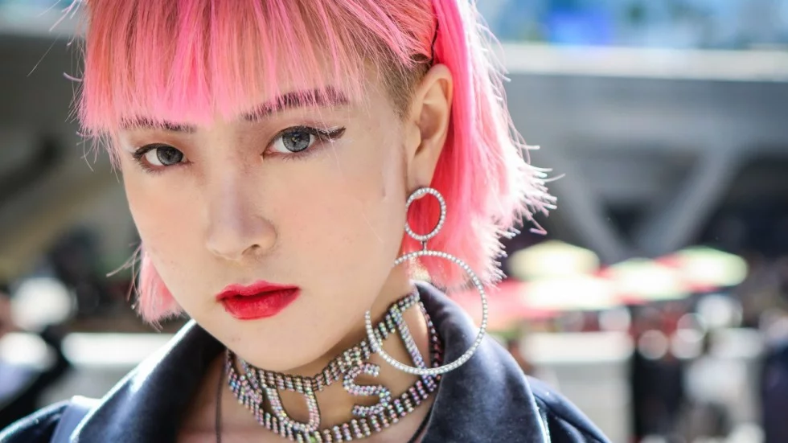

Slide 15
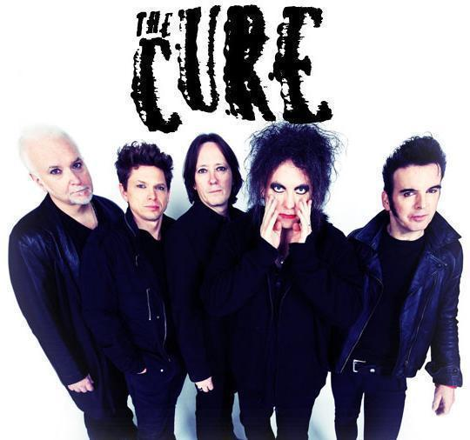
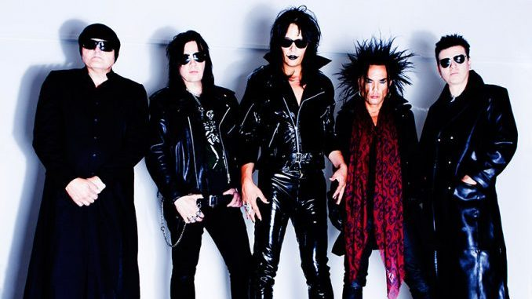
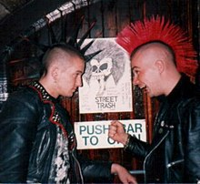

Slide 16
K-POP CONCEPTS

Slide 17
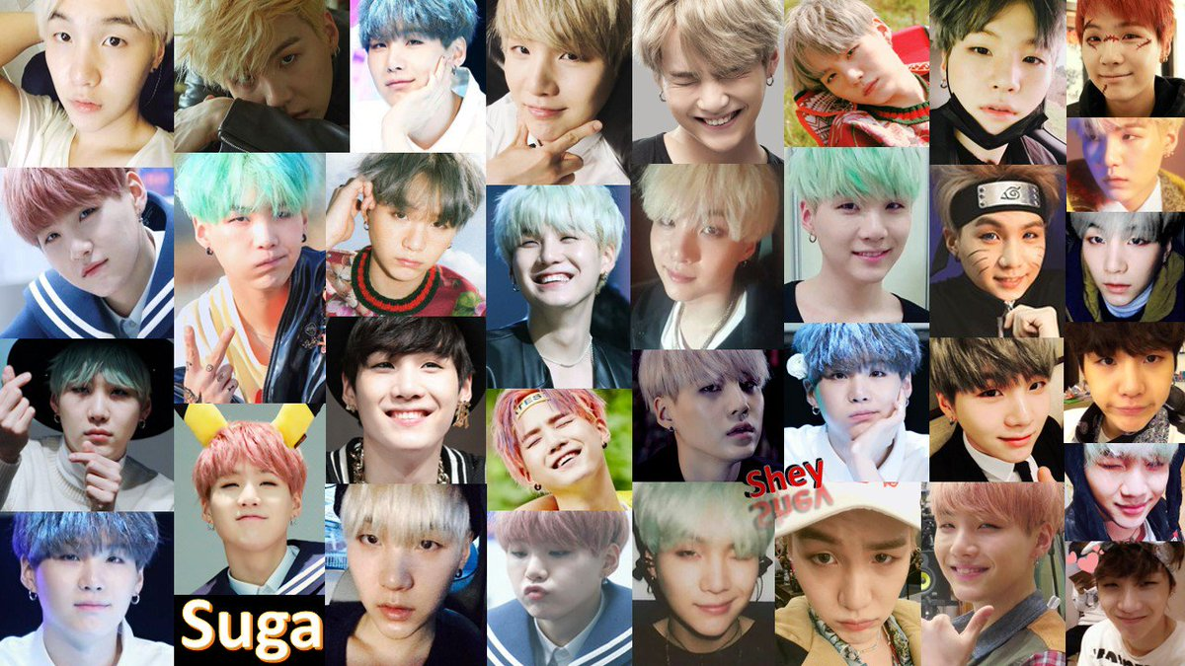
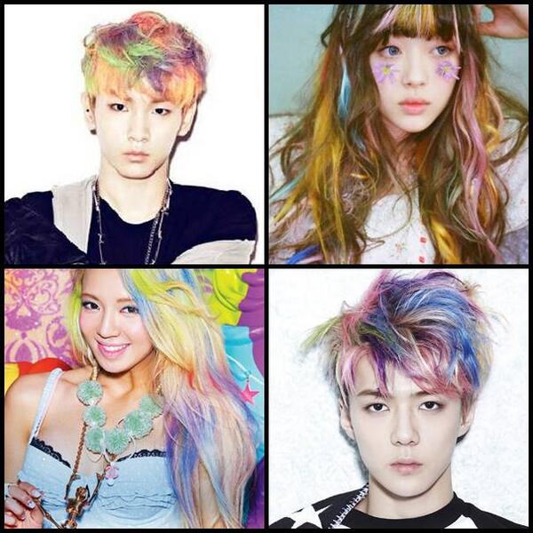
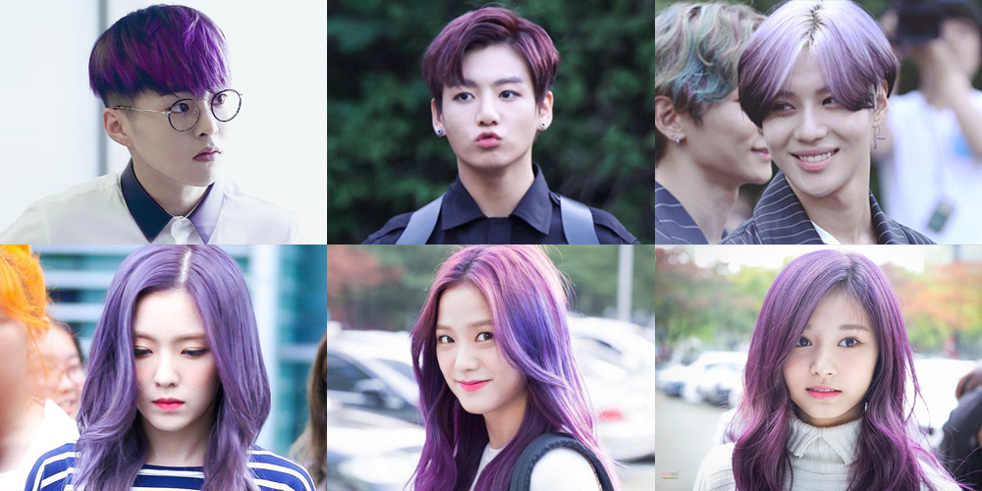
Hairstyle

Slide 18
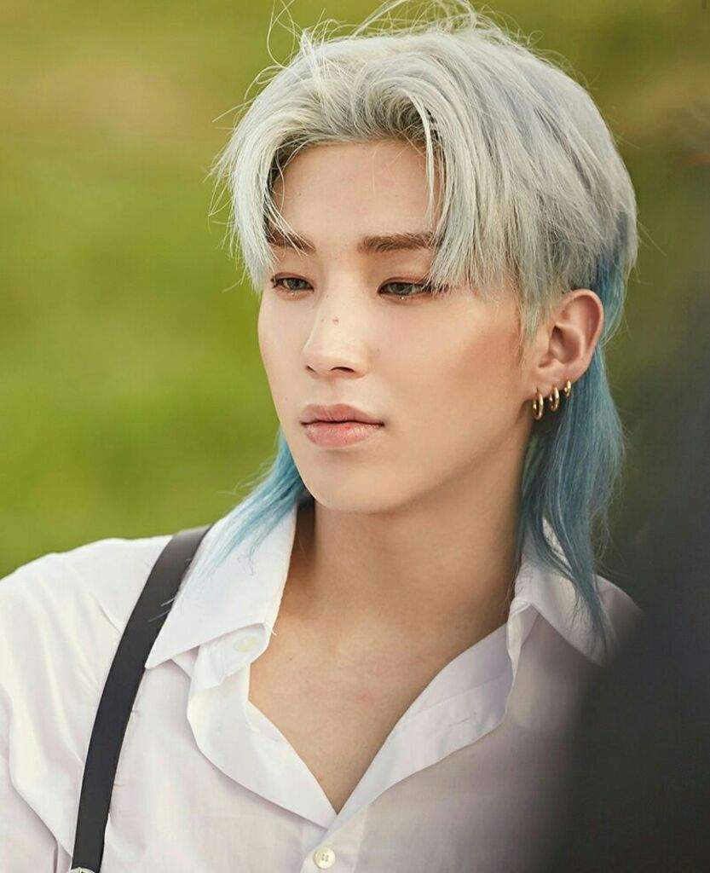
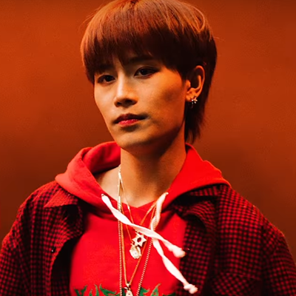
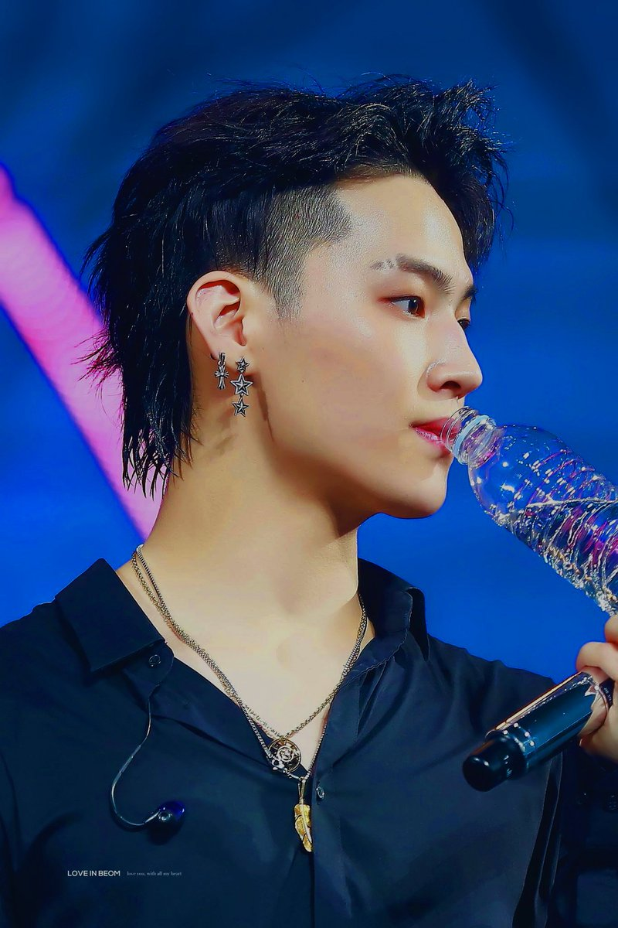
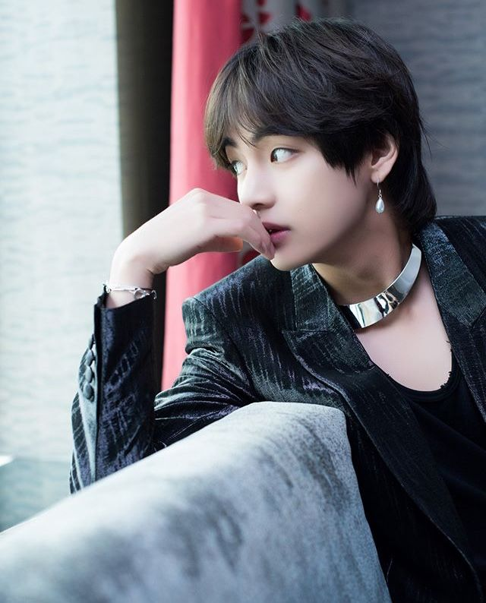
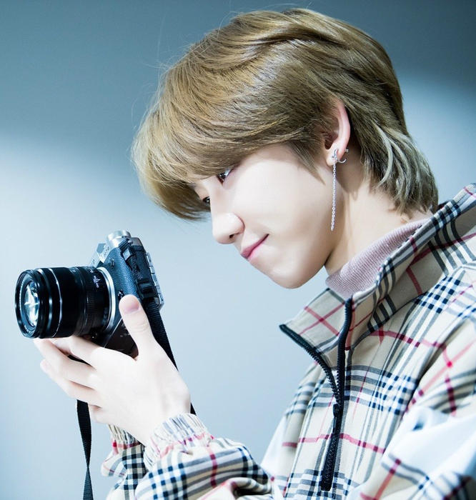
why

Slide 19

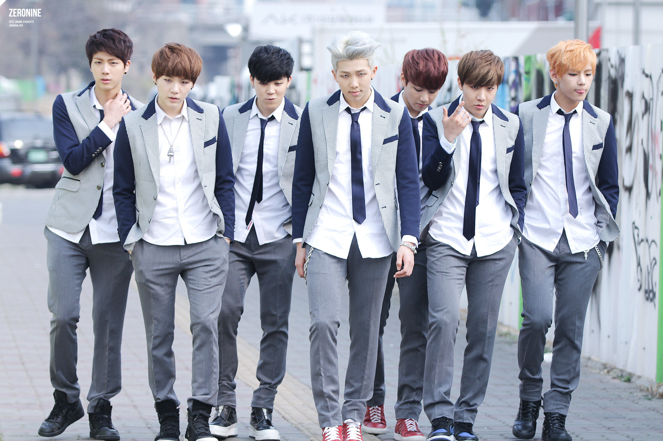
uniforms

Slide 20
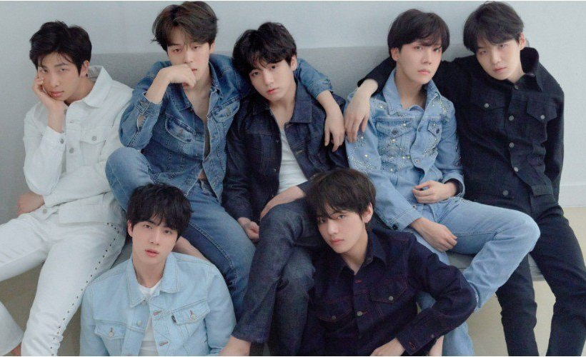
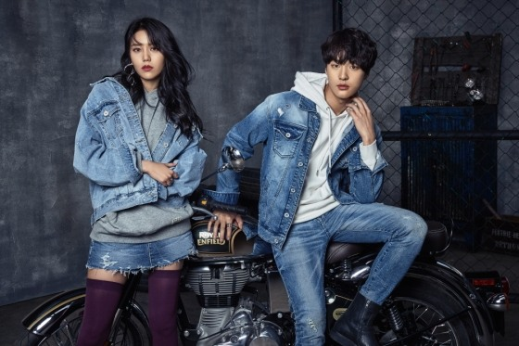
denim

Slide 21
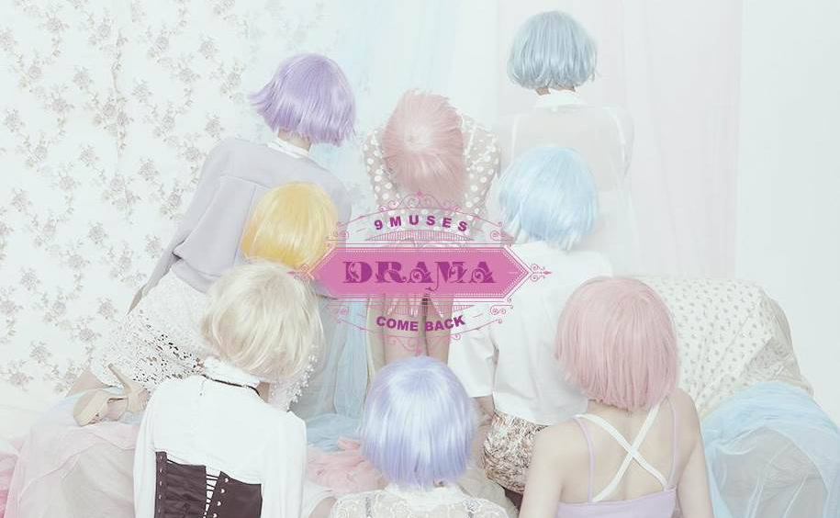
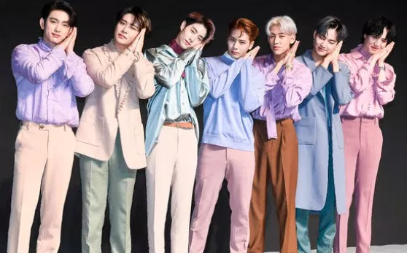
pastels

Slide 22
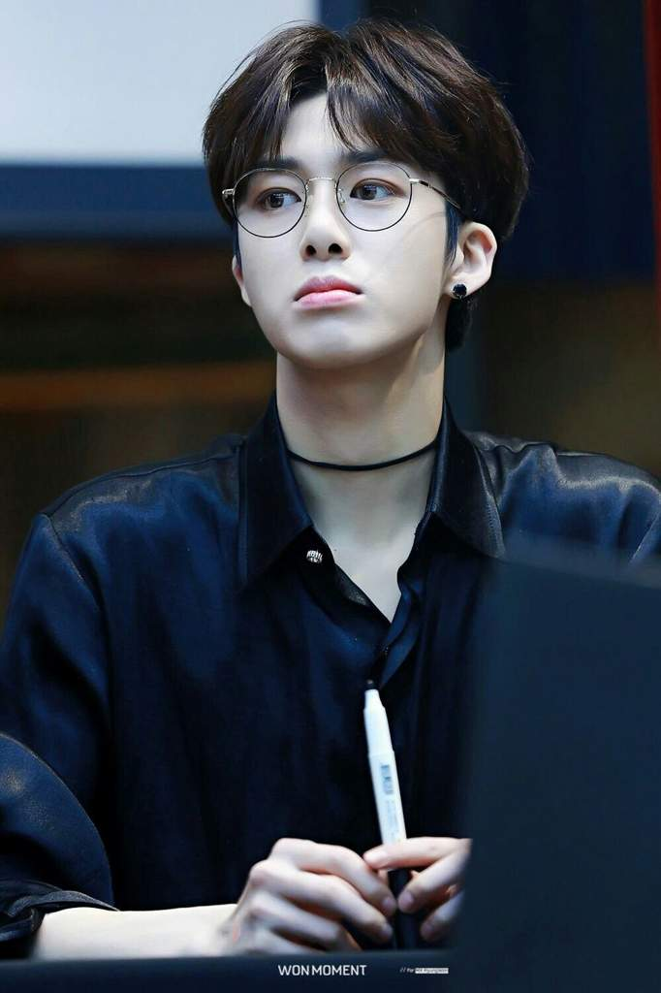

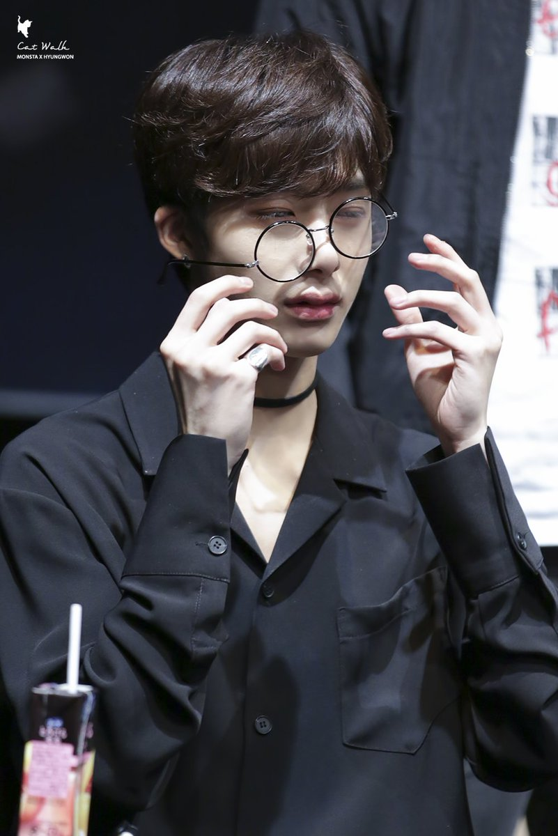
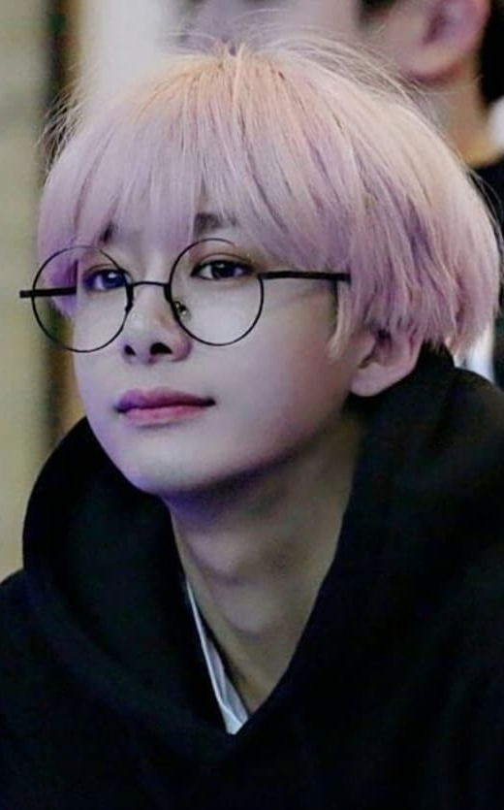
glasses

Slide 23
beauty

Slide 24
overview
misconception: Westernization
skin
eyes
nose

Slide 25
plastic surgery
highest rate of plastic surgeries per capita in the world
1 million surgeries per year
women 19-29:1 in every 2 to 3
most common: blepharoplasty (double eyelid)
$2,000 - $4,000 USD

Slide 26
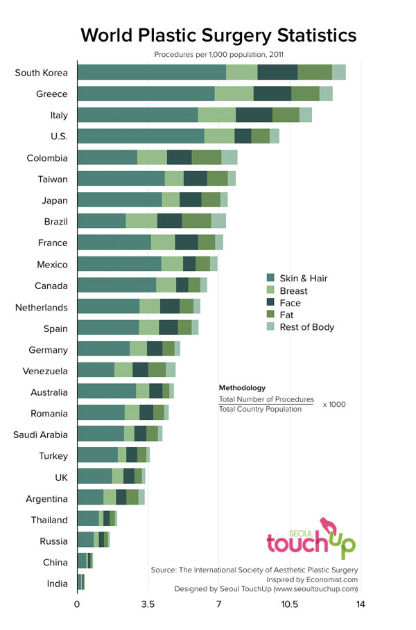
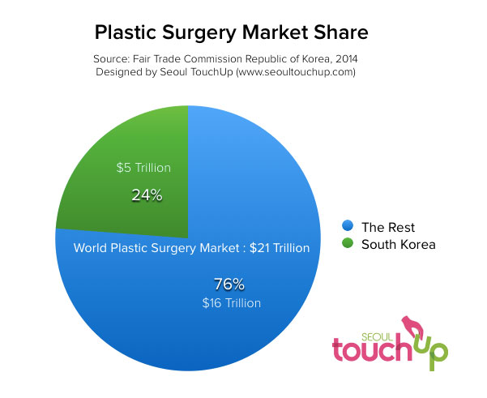
International society of aesthetic plastic surgery
2.47%
2014

Slide 27
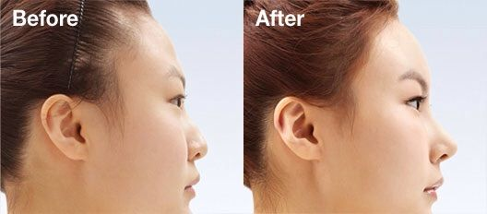
Round forehead

Slide 28
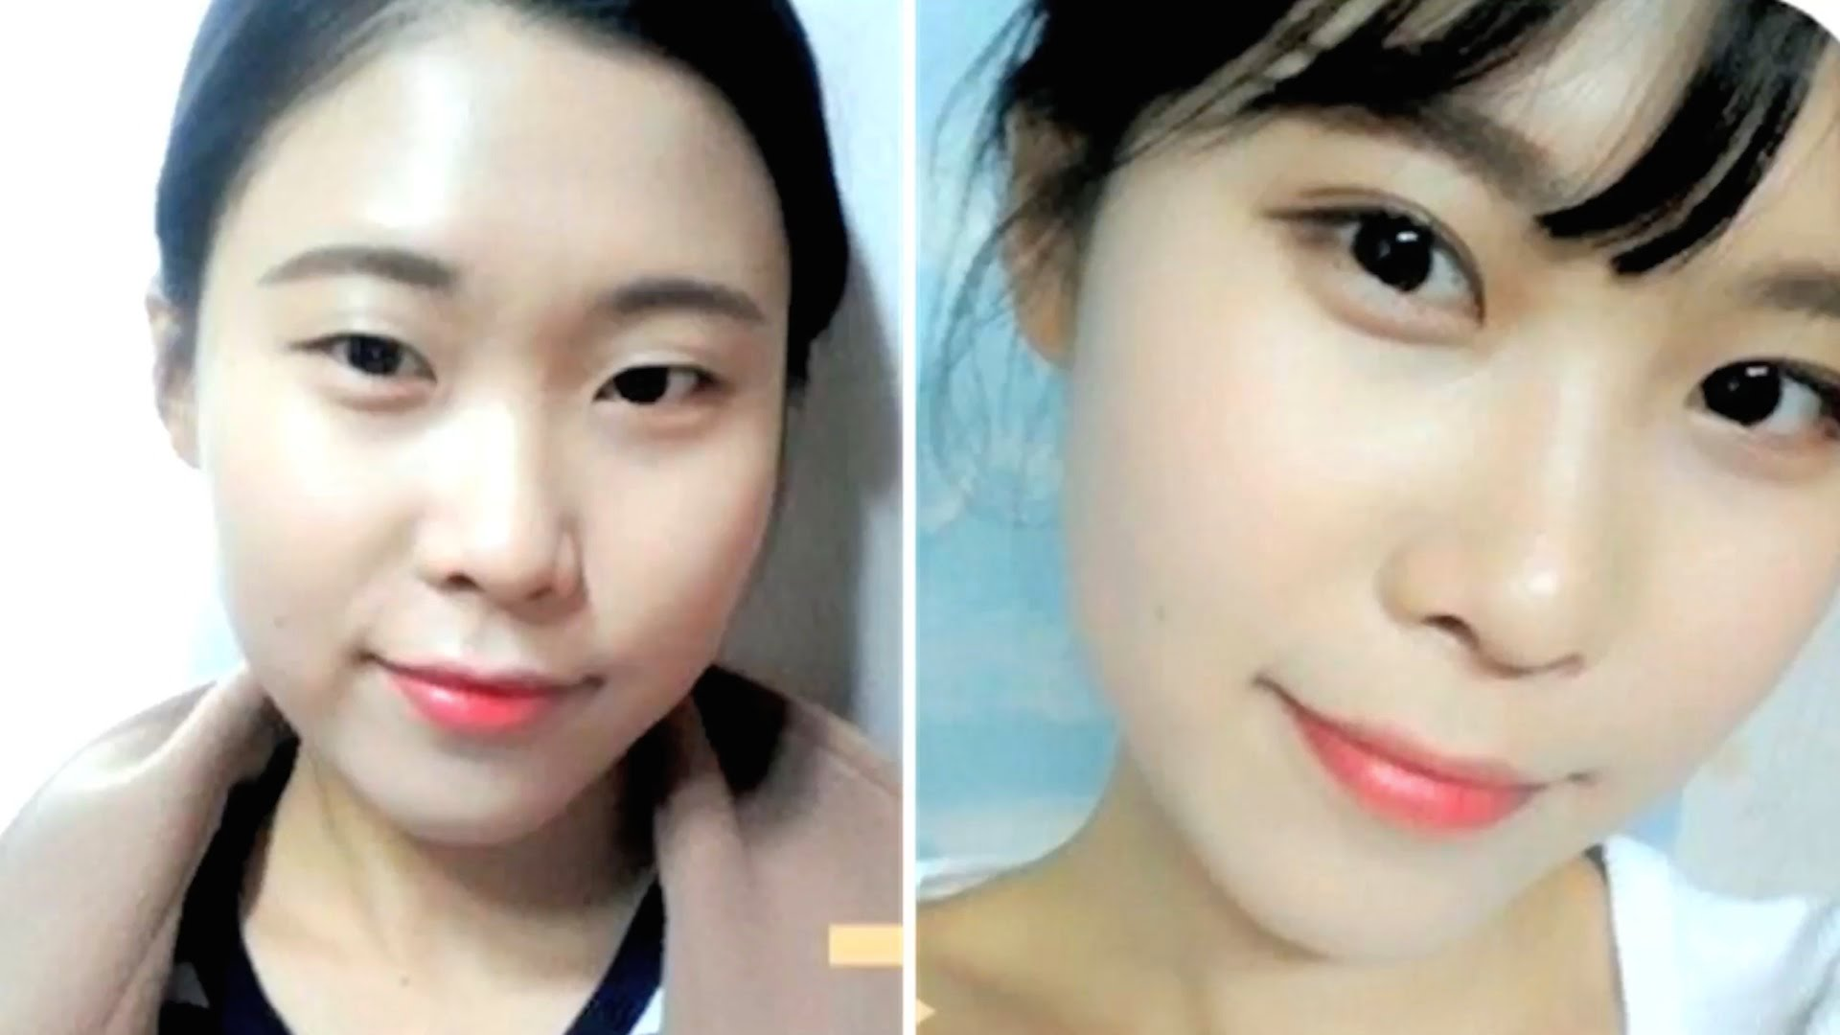
Double eyelids & protruding eyebag

Slide 29
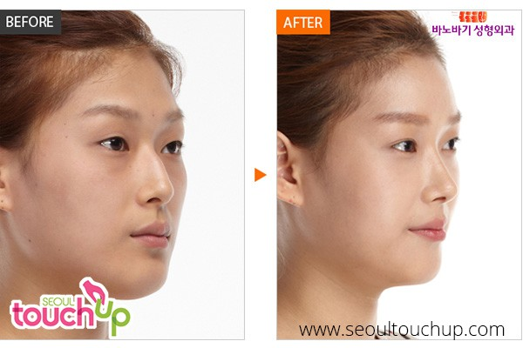
Medium-sized nose bridge

Slide 30

V-shaped face

Slide 31
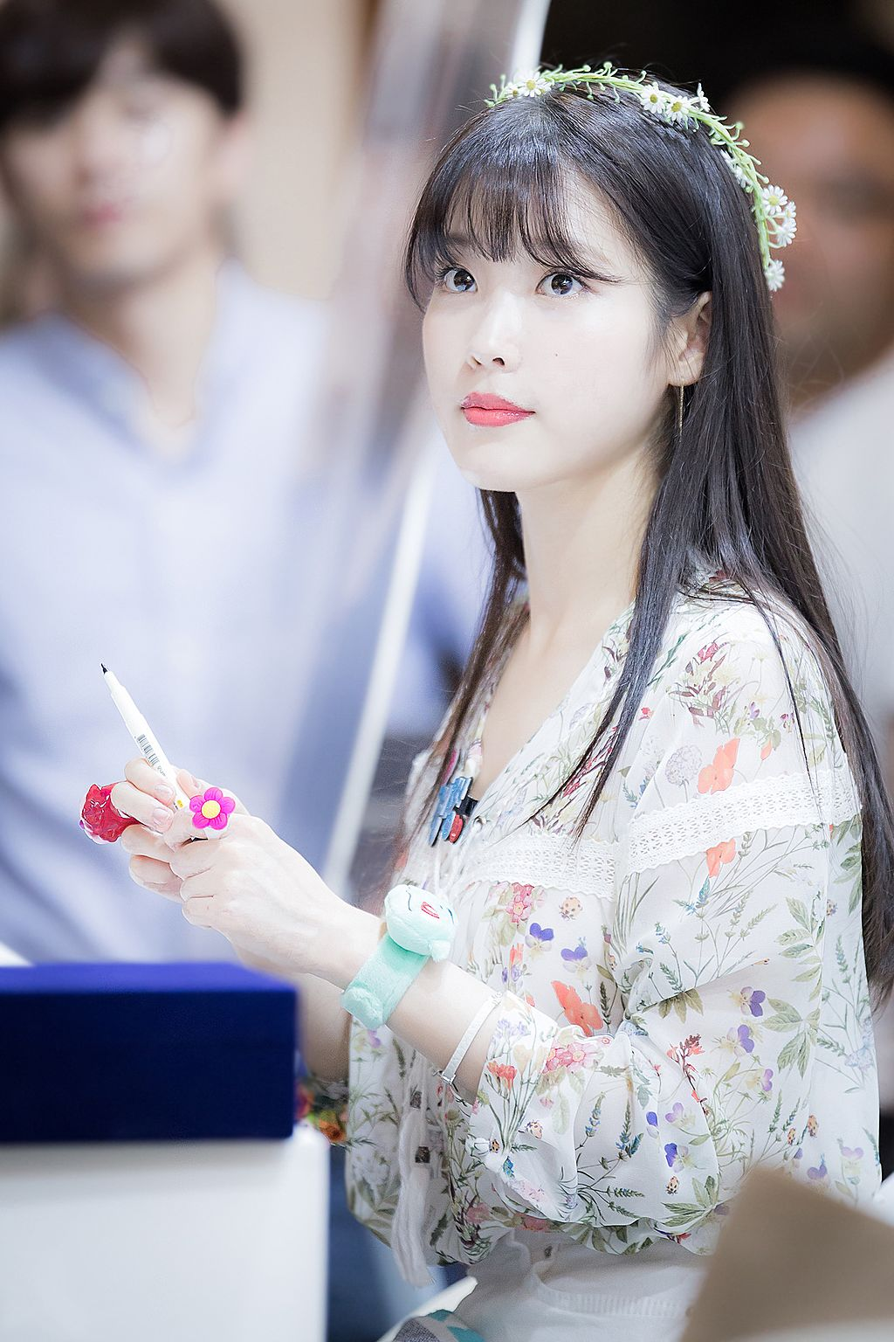
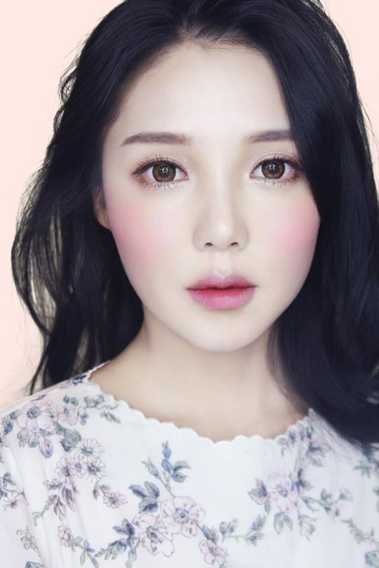
Pale skin

Slide 32
makeup
similar goals
skin color, face shape
Western interest
Yves Saint Laurent
Primark
focus :
BB cream/cushion compact
concealer
eyes + brows
color: blush, lips

Slide 33
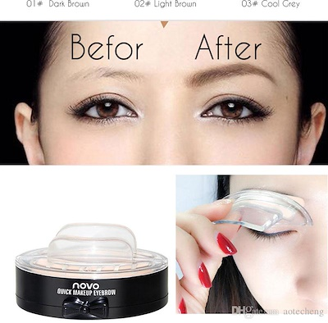
eyebrow stamps

Slide 34

scotch tape/facelift tape

Slide 35
Warning: viewer discretion advised

Slide 36

cornstarch + liquid foundation nose
*chinese

Slide 37

gradient lip

Slide 38
Skin care

Slide 39


10-step routine

Slide 40
References
http://www.harpersbazaar.com.sg/fashion/street-style/seoul-fashion-week-ss18-street-style/
https://10times.com/seoul-fashion-week
https://www.soompi.com/article/1033025wpp/stage-everday-life-fashion-trends-inspired-k-pop-stars
https://www.trazy.com/experience/detail/seoul-fashion-festival-2018-halloween-red-moon
https://www.theodysseyonline.com/you-probably-arent-attractive-in-south-korea
https://sokoglam.com/pages/the-korean-skin-care-routine
https://www.rebelsmarket.com/blog/posts/fashion-style-trends-from-seoul-south-korea-you-didn-t-know
https://www.businessinsider.com/south-korea-plastic-surgery-gangnam-biggest-misconception-2018-6
https://www.seoultouchup.com/korean-plastic-surgery-statistics/
http://www.myfatpocket.com/beauty/beauty-trends/south-korean-women-are-using-this-tape-to-achieve-a-smaller-face.html
https://www.youtube.com/watch?v=3NPbD4soNXQ
https://tradingeconomics.com/south-korea/gdp

